Slide 1
t
@taginspector
Tag Management Systems
2.28.17
Confidential property of Tag Inspector. Not to be disclosed, reproduced, distributed or used for any unauthorized purpose without Tag Inspector’s prior written authorization.
2016 InfoTrust, LLC. All Rights Reserved.

Slide 2
t
@taginspector
About Tag Inspector & Your Presenter
Lucas Long
Tag Inspector Product Manager & Tag Management Consultant
Tag Inspector is a product of InfoTrust, LLC.
Web analytics, tag management, and product development
2,000+ sites analyzed and supported annually
30+ digital marketing and training programs a year
Offices: Cincinnati, USA and Dubai, UAE

Slide 3
t
@taginspector
Agenda
The Central Data Layer
Major Players
Summary and Q&A
Introduction to Tag Management Systems
Selection Considerations for a TMS
Implementation and Migration

Slide 4
t
@taginspector
Tag Management Systems
How they work
Why they are in use
Primary value propositions

Slide 5
t
@taginspector

Slide 6
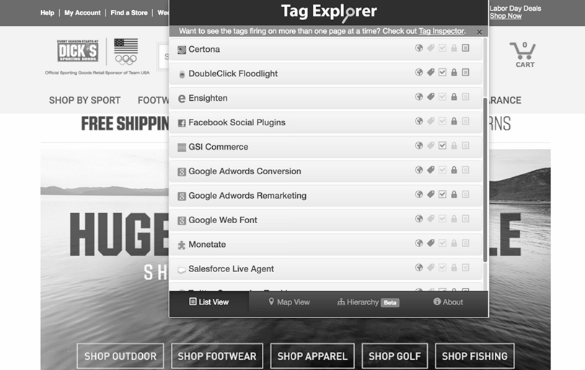
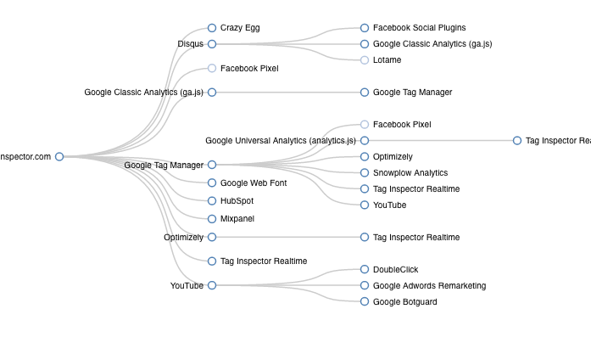
t
@taginspector

Slide 7
t
@taginspector
Tag Management
Systems
Why in use
Central organization of tags
Common variables and firing rules
Offline interface (simplicity)
Primary Value Propositions
Manage tracking pixels in marketing and not in engineering
Performance improvements
Dynamic ability for releases and updates
Ease of migration and migration

Slide 8
t
@taginspector
Agenda
The Central Data Layer
Major Players
Summary and Q&A
Introduction to Tag Management Systems
Selection Considerations for a TMS
Implementation and Migration

Slide 9
t
@taginspector
The Data
Layer
What it is
JavaScript object on page with all relevant information
Central place to push all necessary tracking data
Structure dependent upon individual requirements
How it works
Data pushed
Page, content, product data live in arrays
Object persists until new page loaded
Application with a TMS
One place all tags reference
Standardized data structure
Sits “between” TMS and site to fuel all tags in TMS
Tealium

Slide 10
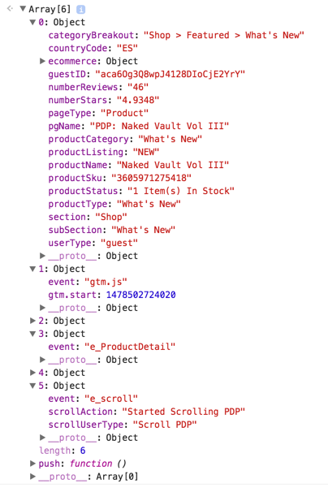
t
@taginspector
The Data
Layer

Slide 11
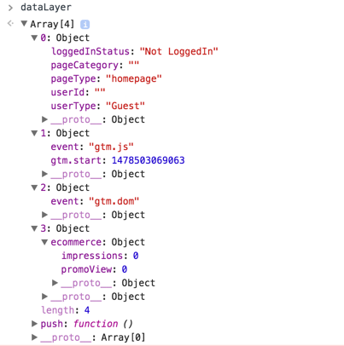
t
@taginspector
The Data
Layer

Slide 12
t
@taginspector
Agenda
The Central Data Layer
Major Players
Summary and Q&A
Introduction to Tag Management Systems
Selection Considerations for a TMS
Implementation and Migration

Slide 13
t
@taginspector
Selection Considerations
What is the primary driver for adoption?
New team managing tags?
Performance?
Organization?
Tags and platforms already in use
Native integrations?
Ease of use
Resources
Paid vs. free solution
Ownership of the tool
Partners working with currently

Slide 14
t
@taginspector
Agenda
The Central Data Layer
Major Players
Summary and Q&A
Introduction to Tag Management Systems
Selection Considerations for a TMS
Implementation and Migration

Slide 15
t
@taginspector
Major TMS
Vendors

Slide 16
t
@taginspector
Agenda
The Central Data Layer
Major Players
Summary and Q&A
Introduction to Tag Management Systems
Selection Considerations for a TMS
Implementation and Migration

Slide 17
t
@taginspector
Implementation &
Migration
Reviewing tags in use
Tag inventory
Business requirements
Data Requirements
Develop migration plan
Data layer architecture
Tags to load via TMS vs. elsewhere
TMS configuration requirements

Slide 18
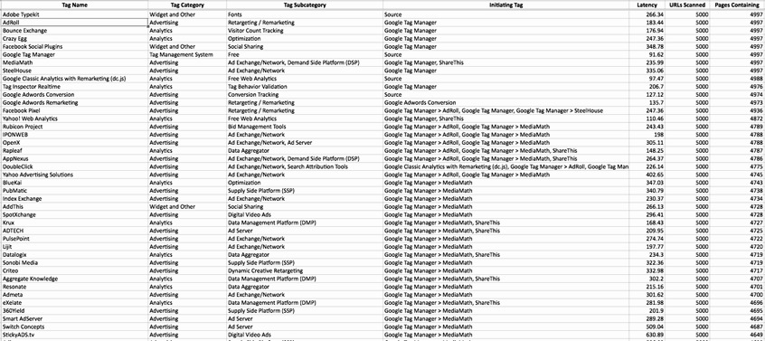
t
@taginspector
Implementation &
Migration

Slide 19
t
@taginspector
Implementation &
Migration

Slide 20
t
@taginspector
Agenda
The Central Data Layer
Major Players
Summary and Q&A
Introduction to Tag Management Systems
Selection Considerations for a TMS
Implementation and Migration

Slide 21
t
@taginspector
Summary
TMS and Data Layer
What each is
How they work together
TMS Options
Selection considerations
Primary options
Implementation and Migration
TMS and Data Layer requirements
Migration plan
Execution

Slide 22
t
@taginspector
Any Questions?
2.28.17
Confidential property of Tag Inspector. Not to be disclosed, reproduced, distributed or used for any unauthorized purpose without Tag Inspector’s prior written authorization.
2016 InfoTrust, LLC. All Rights Reserved.

